Slide 1



Pulsar Meetup
Beijing 2023
Matteo Merli
Apache Pulsar PMC Chair
CTO StreamNative
Introduction

Slide 2
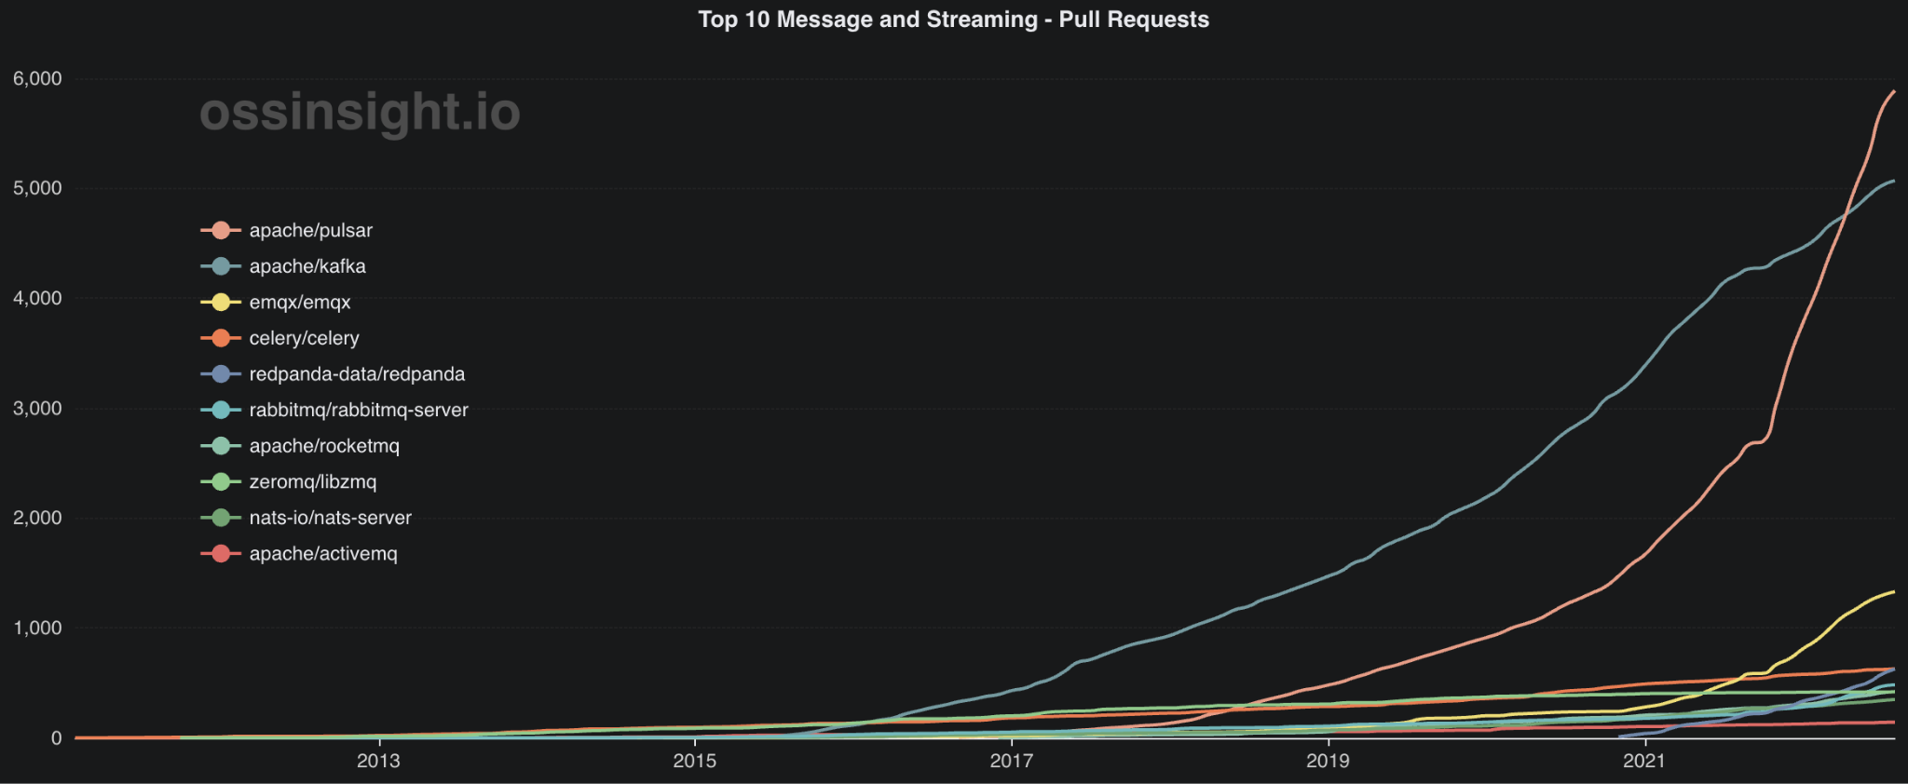
From incubation to a Top-5 ASF project
HUGE GROWTH IN THE COMMUNITY
Notes:
The first time I saw this bar chart race, I was really excited! I am super proud of the achievement that we have achieved as a community. This has been a time of incredible growth for this group.

Slide 3

Distributed Pub-Sub Messaging Platform
HUGE GROWTH IN THE COMMUNITY
Unified API
Multi Tenancy
Cloud-Native Architecture
Geo-replication

Slide 4










Comprehensive client libraries
HUGE GROWTH IN THE COMMUNITY
Client Libraries

Slide 5



First streaming data system introduced tiered storage
HUGE GROWTH IN THE COMMUNITY
Data Offloaders
(Tiered Storage)
Client Libraries

Slide 6




The data system for unified batch and streaming
HUGE GROWTH IN THE COMMUNITY
Processing Engines
… and more!
Data Offloaders
(Tiered Storage)
Client Libraries

Slide 7
Introduce Pulsar Functions: serverless event processing
HUGE GROWTH IN THE COMMUNITY
Pulsar Functions
(Lightweight Stream Processing)
Processing Engines
… and more!
Data Offloaders
(Tiered Storage)
Client Libraries

Slide 8













Connectors: integration with broader data ecosystem
HUGE GROWTH IN THE COMMUNITY
Connectors
(Sources & Sinks)
… and more!
Pulsar Functions
(Lightweight Stream Processing)
Processing Engines
… and more!
Data Offloaders
(Tiered Storage)
Client Libraries

Slide 9


Multi protocol streaming data platform
HUGE GROWTH IN THE COMMUNITY
Protocol Handlers
Connectors
(Sources & Sinks)
… and more!
Pulsar Functions
(Lightweight Stream Processing)
Processing Engines
… and more!
Data Offloaders
(Tiered Storage)
Client Libraries

Slide 10




Pulsar ranked as a Top 5 ASF project
HUGE GROWTH IN THE COMMUNITY
> 600+
> 10,000+
> 11,000+
> 5,000+
Organizations using Pulsar
Contributors
Slack Members
Commits
Notes:
There’s more than 560 contributors making their contributions to Pulsar and there are more making contributions to the ecosystem surrounding around Pulsar. The number of Slack members was doubled last year. There is a really rich and growing collection and body of knowledge of questions, and suggestions, and problems, and patterns and contributions. The entire Pulsar codebase has more than 10,000 commits and it is growing year over year. There’s thousands of organizations that are using Pulsar. And it’s been really incredible to watch this grow.

Slide 11
































Pulsar has already been deployed by thousands of companies across the globe
HUGE GROWTH IN THE COMMUNITY
Notes:
This is a snapshot of the companies who are using Pulsar from MarTech, to Financial Services, to IoT, Manufacturing, to Retail and e-commerce, and more. Pulsar is used for powering mission-critical business applications. For example, if you are a WeChat user and you send Lucky Money to your friends. These went through Pulsar. Tencent is using Pulsar to build its entire billing platform for supporting 100s of billions of transactions every day. Didi is using Pulsar for delivering the real-time experience for their passengers and drivers. Companies like Flipkart, Verizon, Yahoo!, Yahoo! Japan are using Pulsar as a company-wide messaging bus for powering all their messaging and streaming needs.

Slide 12






Verticals and use cases
HUGE GROWTH IN THE COMMUNITY
FinTech
• Threat detection
• Fraud prevention
• Customer 360
• Personalization
eCommerce
• Dynamic pricing
• Digital payments
• Omnichannel inventory optimization
AdTech
• Real-time bidding
• Ad serving/exchange
• Personalized promotions
• Identity graph
IoT
• Predictive maintenance
• Track and trace
• Connected supply chain
• Geo-location based alerts
Telecommunications
• Network optimization
• Churn prevention
• Real-time in-service promos and discounting
Lakehouse
• Data pipeline acceleration
• Real-time analytics and insights
• Real-time alerts and notification

Slide 13

Pulsar 3.0
and beyond

Slide 14

Long Term Support

Slide 15
LTS – Predictable releases and support
The 2 main goals for Pulsar LTS model are:
Provide a path for longer support of releases → users shouldn’t be forced to upgrade all the time
Provide a path for fast innovation -> we want to continue make Pulsar better!

Slide 16
LTS – Stable and frequent features
Help users decide which Pulsar version they should be using:
LTS release → More stable (only fixes are backported)
Feature releases -> Newer features and improvements – Needs to update more frequently

Slide 17
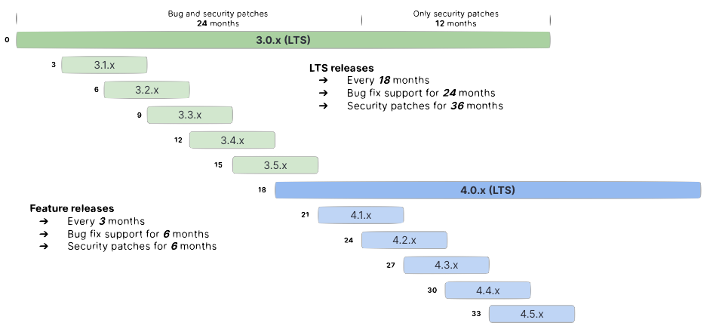
LTS – Support model

Slide 18
LTS – Upgrade & Rollback
Pulsar always has supported live upgrade & rollback between ±1 minor version.
With LTS, it’s now always guaranteed to have live upgrad & rollback ±1 LTS version. Eg.
3.0 -> 3.5 -> 3.0
3.0 -> 4.0 -> 3.0
3.1 -> 4.0 -> 3.1

Slide 19
Performance Improvements

Slide 20
Performance Improvements
Pulsar 3.0 comes with BookKeeper 4.16 which carries a lot of improvements aimed at reducing CPU usage and contention.
These changes greatly improved the throughput and latency in cases where:
Many topics are used
Message batching is disabled/ineffective

Slide 21
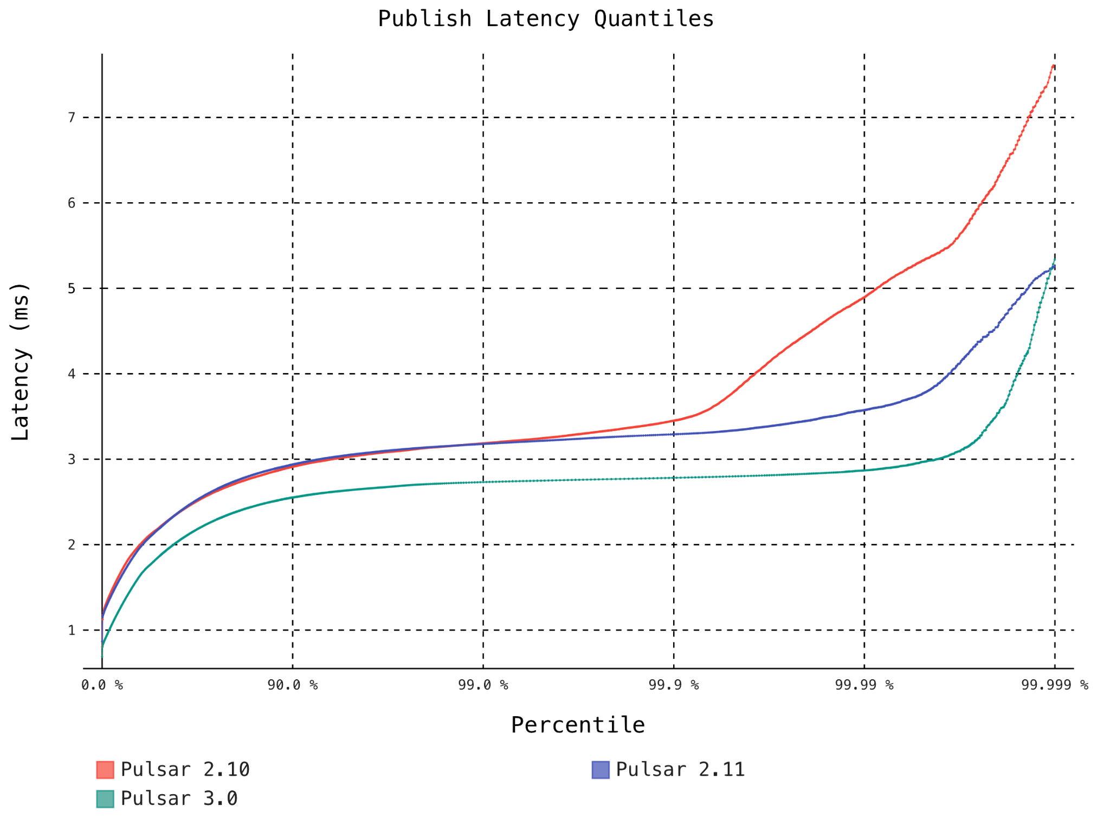
Performance Improvements
3 nodes cluster
1 topic
100 MB/s

Slide 22
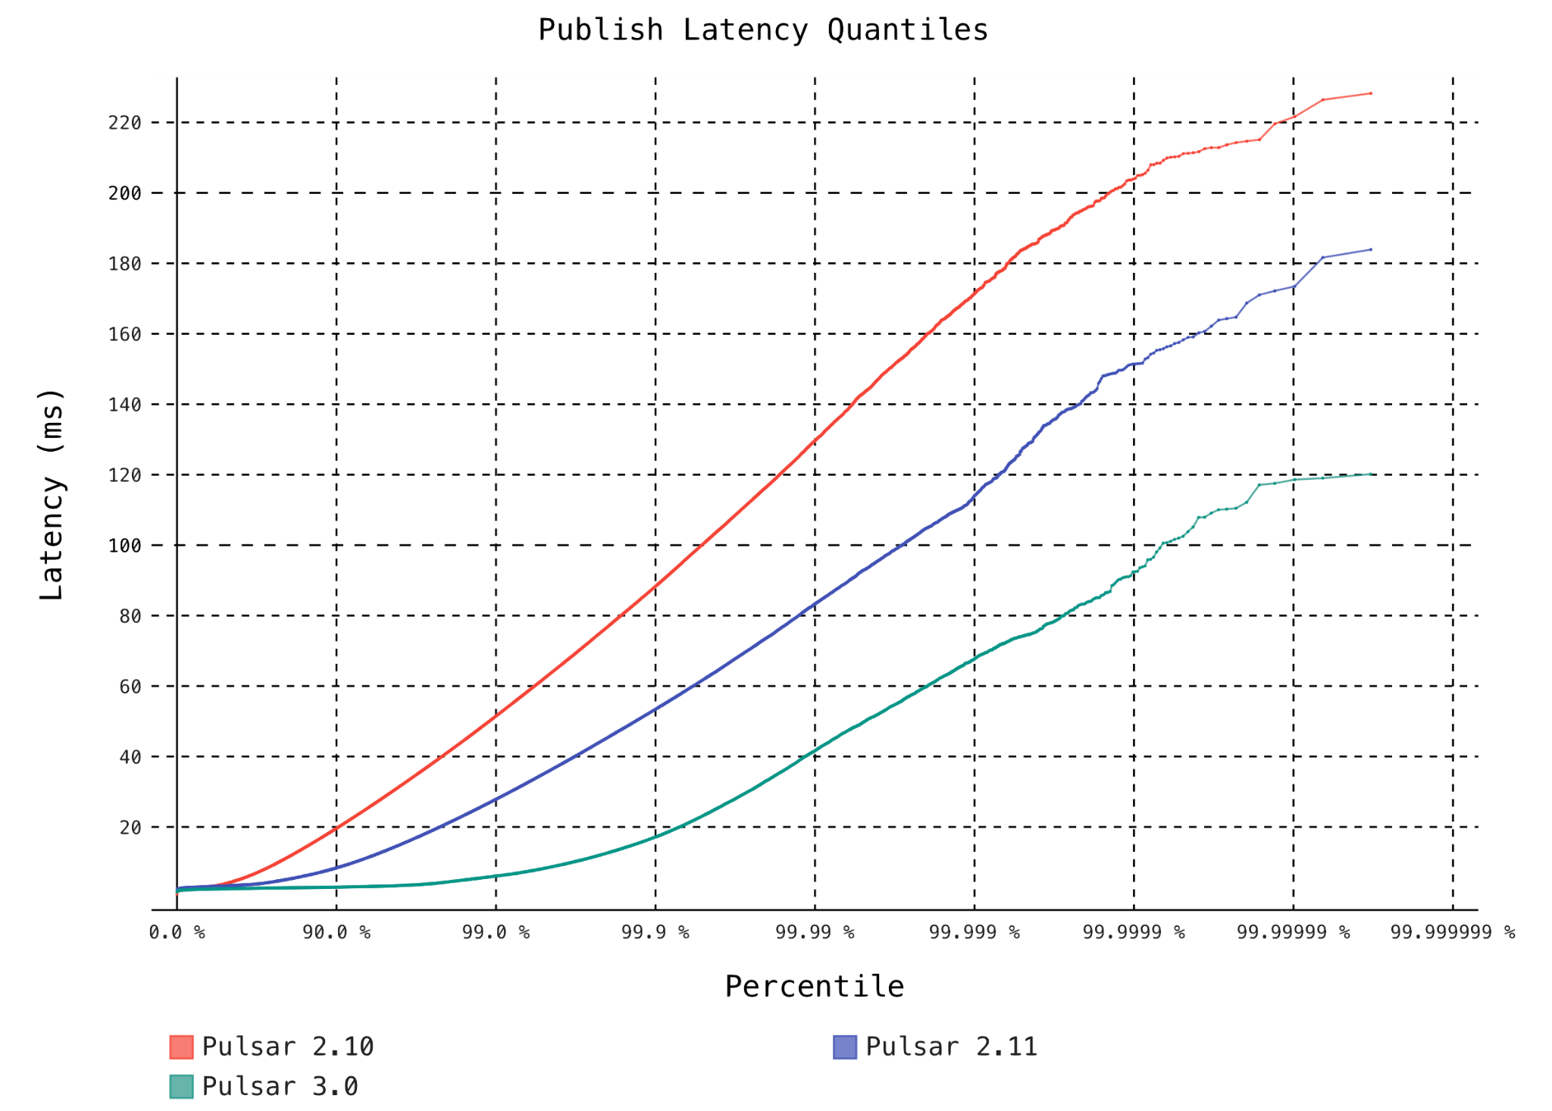
Performance Improvements
3 nodes cluster
10K topics
100 MB/s

Slide 23
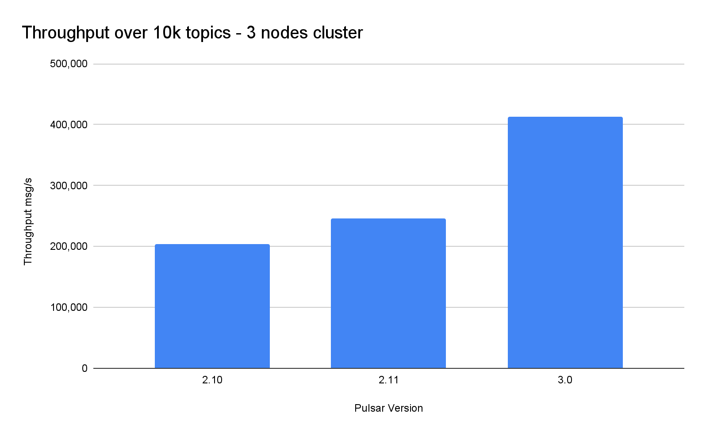
Performance Improvements

Slide 24
BookKeeper with Direct IO
BookKeeper 4.16 has now a way for the EntryLogger to completely bypass the OS PageCache and use direct IO for read & write operations.
This greatly improve the IO speed, especially in containerized environments, where the OS has to share the page cache and enforce quotas.

Slide 25
Scalable delayed delivery
PIP-195 introduced a new mechanism that uses bucket system to tracked delayed messages
The amount of delayed messages is not anymore tied to memory capacity
Improves the stability of broker and isolation between tenants when using delayed delivery

Slide 26
New Load Balancer

Slide 27
PIP-192 - New Load Balancer
We have been working to improve the way traffic is balanced across a Pulsar cluster.
Goals:
Ensure traffic is well balanced in cluster, even in presence of spiky loads
Ensure cluster reaches ideal state in shortest possible time
Minimize topic unavailability time during reassignments

Slide 28
PIP-192 - New Load Balancer
Implementation notes:
Uses a Pulsar topic to manage ownership of bundles of topics
Uses a Pulsar topic to propagate each broker load → fast feedback loop for accurate information
Introduced the concept of “transferring” topics from broker A to broker B

Slide 29
PIP-192 - New Load Balancer
Current work:
Since we now have topic-transfer, we are going to improve the graceful handover of topics between broker.
→ Avoid any client based retry logic to reduce latency spikes

Slide 30
Multi-Arch images
Docker images are now available for x86-64 and Arm-64
Pulsar docker image works great on Mac M1 / M2
It’s possible to deploy Pulsar on ARM based servers

Slide 31
The road ahead

Slide 32
Improve user experience
Messaging systems are still very hard to use
Users (applications developers) are often confused about how to use features
Tuning for best performance can be quite hard

Slide 33
Unlock new use cases
Pulsar already supports up to 1M topics
Though it requires non-trivial deployment for that
Also, today this is an upper limit
By having Pulsar to efficiently support 10M or 100M topics, we can unlock many use cases that today are not possible

Slide 34
Multiplexing - Demultiplexing
Instead of using 1 single partitioned topic
Use 1 topic per each domain resource (eg: customer, session, campaign)
Application developers can easily map the business domain into the messaging domain
Allows to have control and visibility of each resource

Slide 35


Pulsar + Oxia
https://streamnative.io/blog/introducing-oxia-scalable-metadata-and-coordination

Slide 36
What is Oxia?
Oxia is a system created & open-sourced by StreamNative to solve metadata & coordination problems at large scale without compromises.
It uses a new architecture that takes advantage of modern cloud native environments.

Slide 37
Rehauling of Metrics

Slide 38
PIP-264 - Enhanced OTel-based metrics
Addressing few problems in Pulsar metrics:
Metrics have grown organically over the years
Many different ways to collect metrics
Many different naming conventions
Different ways to retrieve metrics values
Not flexible way to configure granularity

Slide 39
PIP-264 - Enhanced OTel-based metrics
We’re moving towards unifying the metric to use Open Telemetry across the board
API to dynamically change aggregation of metrics (eg: per-topic, per-namespace) and filtering

Slide 40
Improving service discovery & session establishment

Slide 41
Optimize topic
Pulsar clients need to discover which broker is serving a particular topic
If a single client uses many topics, this process becomes inefficient, with individual calls for each topic
We should instead have a better way to describe the current assignments and propagate any changes

Slide 42
Improving service discovery
Pulsar clients need to discover which broker is serving a particular topic
If a single client uses many topics, this process becomes inefficient, with individual calls for each topic
We should instead have a better way to describe the current assignments and propagate any changes

Slide 43
Improving session establishment
Similarly to service discovery, if we’re trying to establish a producer session over many topic, we can avoid repeating many tasks:
One RPC per broker
Single check for schema / permissions

Slide 44
Conclusion
Pulsar 3.0 started a new chapter in how Pulsar releases are managed
Many improvements in 3.0/3.1 and many other coming in 2024
We are now better positioned to deliver features & improvements, fast & safely

